Slide 1
VECTORI
Teaching platform for physics laws
Notes:
Introduce the engineering team and outline the core mission: building a modern, decoupled web platform that makes fundamental physics visual and interactive for engineering students.

Slide 2
Our motivation
The Problem
Our Vision
Key Goals
Kinematics, mechanics, and electromagnetism are difficult to master through static textbook diagrams and formula memorization alone.
Visualize core physical laws in real time through dynamic mathematical models and interactive parameter manipulation.
Deliver functions through simple graphics, an extensible calculation module structure.
Notes:
Emphasize the cognitive gap students experience when moving from lecture equations to real-world mechanical intuition. Our platform bridges this with active, visual experimentation.

Slide 3
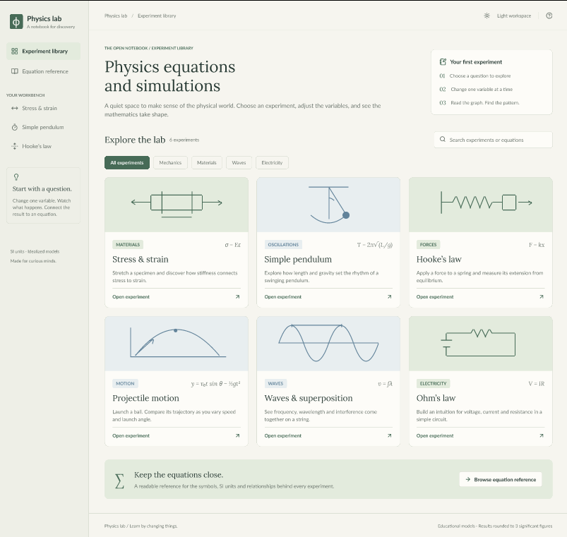
Design
Mockup by Figma
Notes:
Emphasize the cognitive gap students experience when moving from lecture equations to real-world mechanical intuition. Our platform bridges this with active, visual experimentation.

Slide 4
Technical foundations
01
02
03
TIER 01 · CLIENT
TIER 02 · SERVER
TIER 03 · CLOUD
React Frontend
Spring Boot Core
AWS & Maven Build
Draws the buttons, graphs, and simulation on the screen.
Spring Boot Runs the backend server and executes the physics calculations. REST API Sends user inputs to Java and sends calculated coordinates back to React.
MAVEN Downloads necessary libraries and builds the Java project (pom.xml). AWS used to Host the website on the internet so others can use it.
Notes:
Walk through the architecture left-to-right: the React canvas handles UI state and rendering, while calculation fidelity is strictly preserved in the Spring Boot backend.

Slide 5
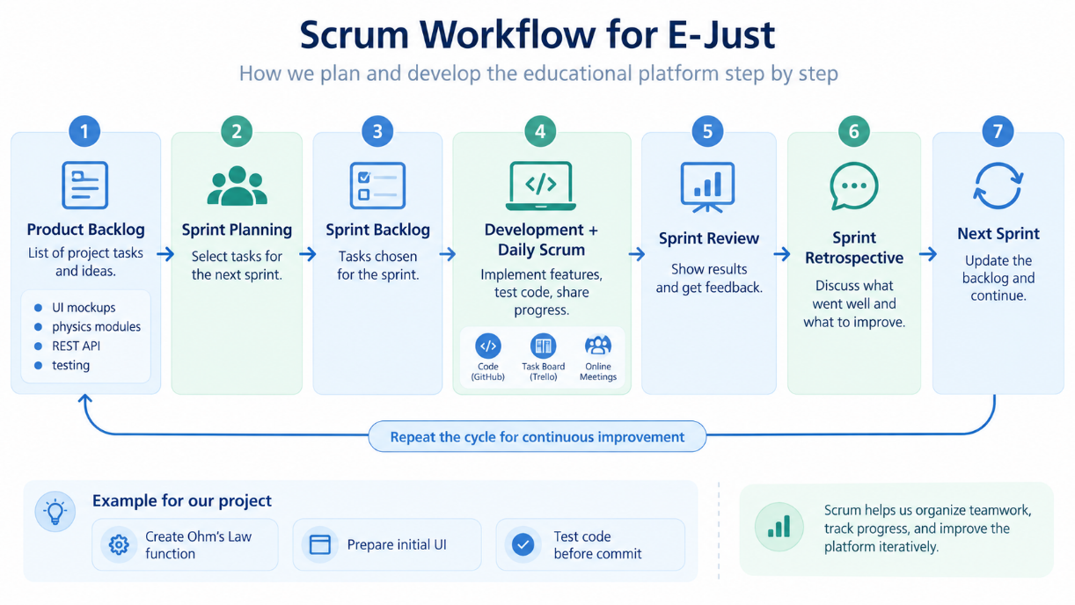
AGILE ENGINEERING PROCESS
Scrum Method
Tooling: Trello (Backlog & Task Board) - GitHub (Sprint Branching)
Notes:
Describe how the team uses two-week sprints to isolate mathematical calculation accuracy before building the visualization layer.

Slide 6
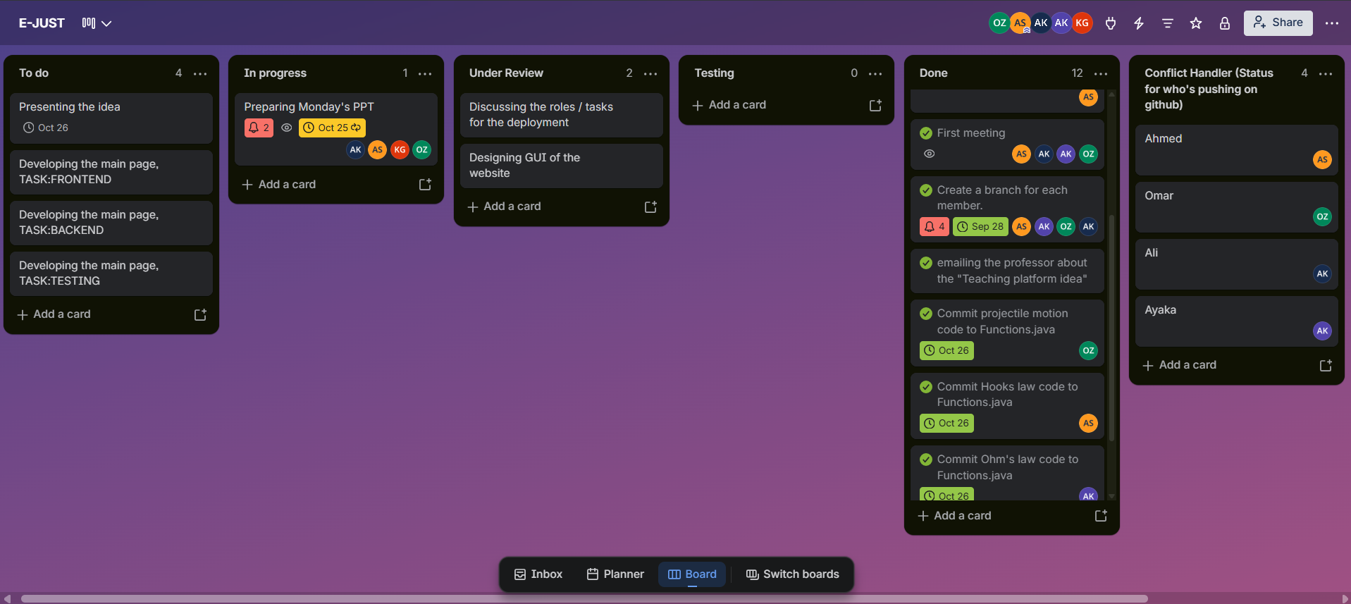
Task Board
Trello Board
Notes:
Describe how the team uses two-week sprints to isolate mathematical calculation accuracy before building the visualization layer.

Slide 7
COLLABORATION & VERSION CONTROL
Our GitHub Repo
REPO ARCHITECTURE
ISOLATION
VERIFICATION
Shared Repository
Branching Model
Quality Standards
Single shared repository containing the Spring Boot backend (com.ejust.Backend), Maven configurations (pom.xml), project docs, and prepared frontend endpoints.
Each contributor worked on a dedicated branch (e.g., Omar, Ali, Ayaka, Sameh) to develop their specific physics formulas in isolation before merging into main.
Changes integrated via Pull Requests with peer review to prevent syntax errors, avoid formula calculation regressions, and resolve Git merge conflicts cleanly.
Notes:
Highlight the branching strategy: main branch is protected, each developer works on an isolated module branch, and automated checks prevent regression.

Slide 8
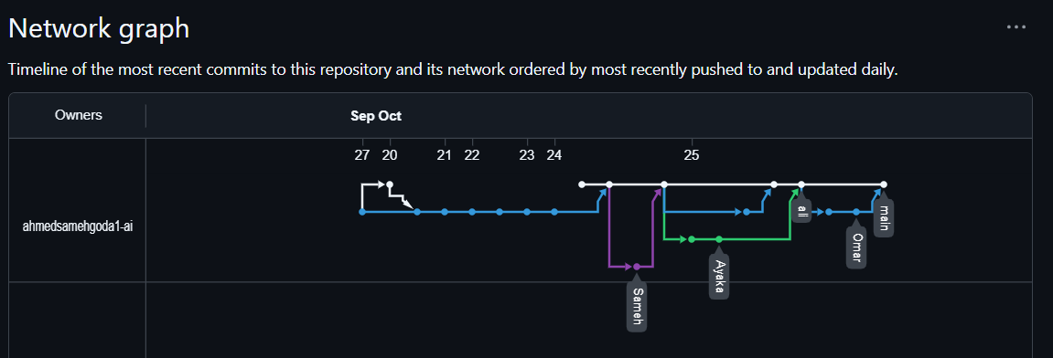
COLLABORATION & VERSION CONTROL
Our GitHub (Branching & Merging strategy)
Notes:
Highlight the branching strategy: main branch is protected, each developer works on an isolated module branch, and automated checks prevent regression.

Slide 9
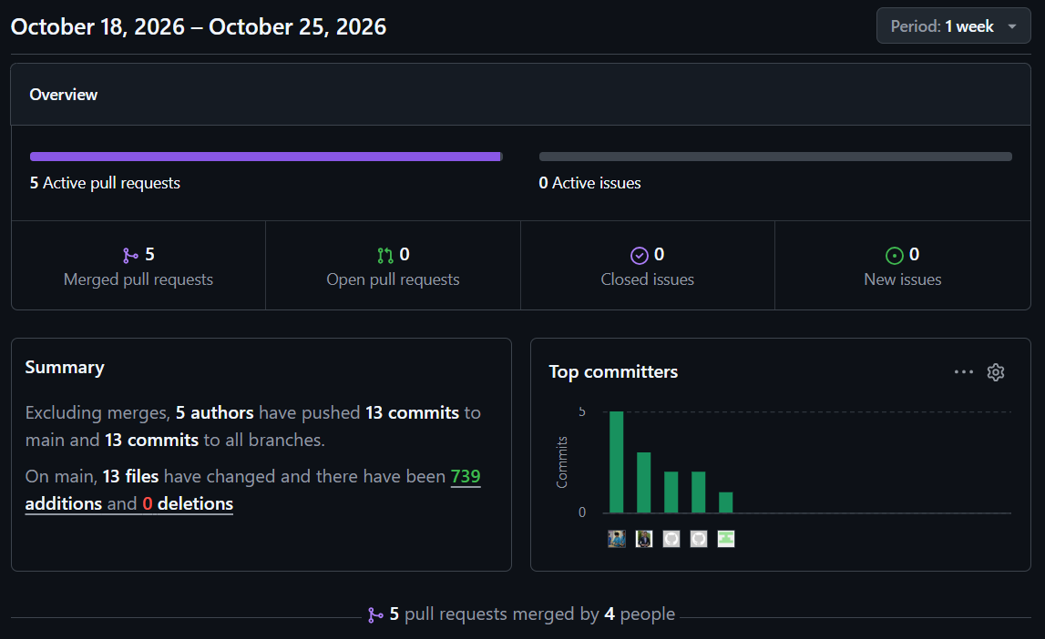
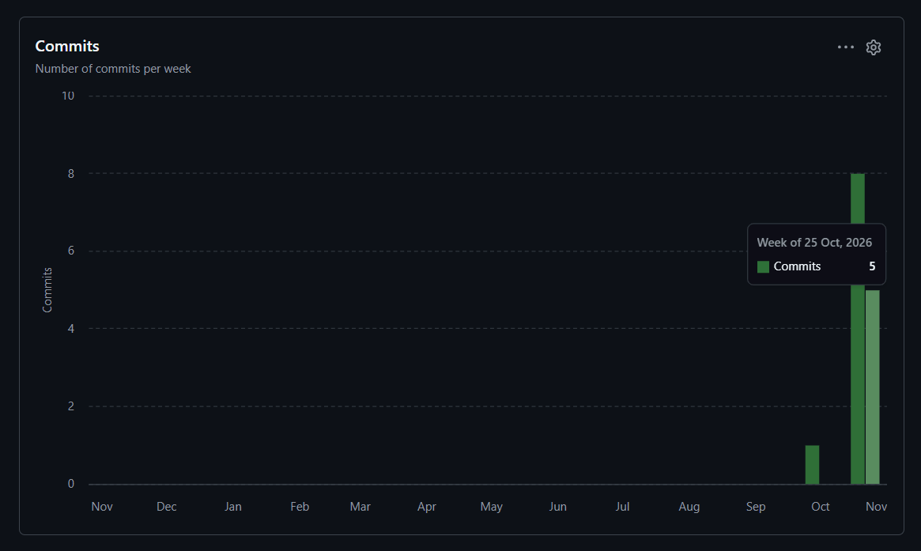
COLLABORATION & VERSION CONTROL
Our GitHub (Repository Metrics & Team Activity)
Notes:
Highlight the branching strategy: main branch is protected, each developer works on an isolated module branch, and automated checks prevent regression.

Slide 10
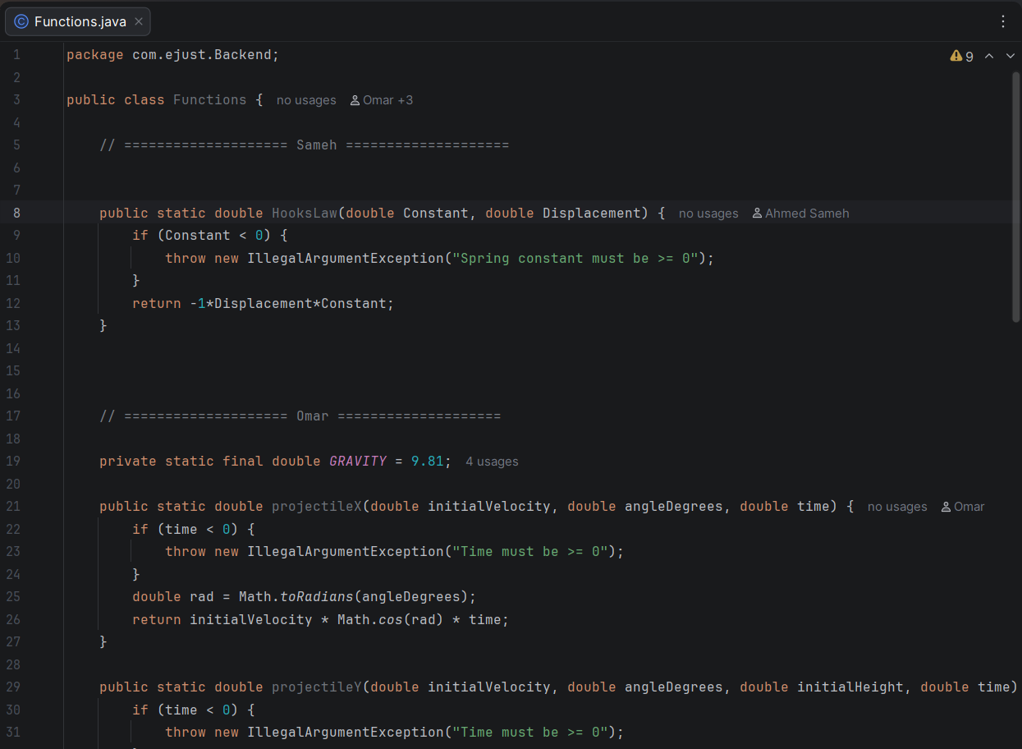
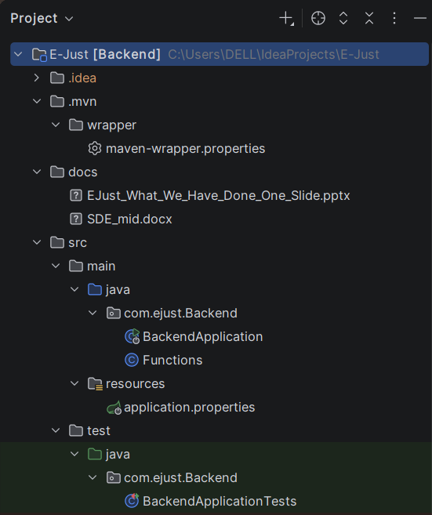
ENGINEERING BUILD
Coding & Implementation
Notes:
Walk through the coding work: Java classes hold the physics logic, React handles the controls and output, REST endpoints link frontend and backend, JUnit tests validate the calculations, and Git branches keep feature work modular.

Slide 11
Roadmap
What's Next:
Engineering Roadmap
Team Workload & Governance
Interactive Frontend (React): Build the Figma-based UI with real-time sliders and input fields.
Visual Simulation Engine: Implement 2D Canvas/SVG animations for trajectories and oscillating springs.
REST API Endpoints: Expose Spring Boot controllers at /api/physics/... for calculation data.
Automated QA & Cloud CI/CD: Add comprehensive JUnit suites and prepare AWS deployment.
4-MEMBER BALANCED DISTRIBUTION
Ayaka · Frontend UI Lead: Web pages, navigation, and user controls (sliders & buttons).
Ali · Graphics & Animation Lead: 2D canvas drawing, motion playback, and visual graphs.
Sameh · Backend & API Lead: Spring Boot web controllers and physics calculation services.
Omar · Security & QA Lead: API rate limiting (DoS prevention), input sanitization, and automated JUnit testing.
DEVELOPMENT RULES & GIT HYGIENE
Zero direct commits to main.
Peer review and passing unit tests before pull request approval.
Trello sprint-board synchronization.

Slide 12
